Slide 1
CNA (Carrier Notification and Approval)
A. Overview of CNA
B. Demo of Screens
1. CAR 2. ROC 3. CSE 4. CAG 5. CIR 6. EAG
7. GNA 8. ENA 9. ENO 10. EAP 11. NOF 12. APR 13. SAP
SMS/800 ® is a registered trademark of SMS/800, Inc.
Notes:
There are 13 screens associated with the CAN feature.
(Click)
1. CAR 2. ROC 3. CSE 4. CAG 5. CIR 6. EAG
And the
(Click)
7. GNA 8. ENA 9. ENO 10. EAP 11. NOF 12. APR 13. SAP

Slide 2
SMS/800 Course Roadmap
15 Reporting
12 CRA
11 ROP
7 LAD
13 Automation
6 CPR
10 ASL
14 Carrier
3 Introduction
8 TAD
4 NUS
2 Benefits
1 Welcome
9 TRQ
5 CAD
16 WEB
Mon.
Tue.
Fri.
Wed.
Thu.
Here You Are
Notes:
(Click) This course is a 5 day course. Monday we will cover the Welcome
(Click) , Benefits
(Click) , Introduction
(Click) , NUS (Reserving numbers
(Click) , and CAD (Building customer records
(Click) . Tuesday we will build Complex Records using the CPR
(Click) . Wednesday we will add Label definitions (LAD) to our complex routing
(Click) . Thursday we will cover several feature screens: TRQ
(Click) , ASL
(Click) , ROP
(Click) , CRA
(Click) , AUTOMATION
(Click) AND CARRIER
(Click) . Friday We will learn how to use the WRS Reporting System
(Click) and review the SMS/800 business website
(Click) . Let us begin…

Slide 3
Introduction of CNA
The CNA (Carrier Notification and Approval) features include screens that allow a Carrier (CIC owner) to manage their CIC in the SMS/800 Database. A CIC has to be associated with a RO Id to access the CNA screens.
The CIC Owner can: 1. Become a Resp Org. 2. Contract with a current RO to manage the CIC screens in SMS/800.
Using the CIC screens, a CIC owner can do the following:
Select which Entities can use their CIC
For the selected Entities, a CIC can set up an approval situation for each CR that uses their CIC.
The CIC must access certain screens to be notified and/or to approve or reject the use of their CIC.
Notes:
(Click)
The CNA (Carrier Notification and Approval) features include screens that allow a Carrier (CIC owner) to manage their CIC in the SMS/800 Database. A CIC has to be associated with a RO Id to access the CNA screens.
(Click)
The CIC Owner can: 1. Become a Resp Org. 2. Contract with a current RO to manage the CIC screens in SMS/800.
(Click)
Using the CIC screens, a CIC owner can do the following:
(Click)
Select which Entities can use their CIC
(Click)
For the selected Entities, a CIC can set up an approval situation for each CR that uses their CIC.
(Click)
The CIC must access certain screens to be notified and/or to approve or reject the use of their CIC.
(Click)

Slide 4
Carrier Screens
CAR
ENO
NOF
SAP
ROC
CAG
GNA
ENA
EAP
APR
DAP
CSE
BY HELP DESK
BY CIC OWNER
BY RESP ORG
Notes:
Three screens are created by the Help Desk after a new carrier submits the correct SMS/800 form 19.
(Click)
The CAR, The ROC and The CSE
(Click)
Seven screens are used by the carrier set up how their carrier is used in SMS. CAG,GNA, ENA, ENO/EAP, NOF/APR
(Click)
Two screens are used by the Resp Org to see responses from a Carrier. SAP & DAP.

Slide 5
CAR (Carrier Information)
Used by the Help Desk to define which carrier codes (CICs) are assigned to an ACNA.
Translation:
B = Accepts both Pots and Dial#
Y=Pots only
N=Dial# only
Notes:
The CAR (Carrier Information) This is the first screen to be created when establishing a new Carrier in SMS/800. Carrier must submit Form 19
(Click) (Click)
Used by the Help Desk to define which carrier codes (CICs) are assigned to an ACNA.
(Click)
The Translation on the CAR screen establishes whether a Carrier allows termination of a call to the Dial# or to the POTs.
B = both Pots and Dial#
Y = Pots only
N = Dial# only

Slide 6
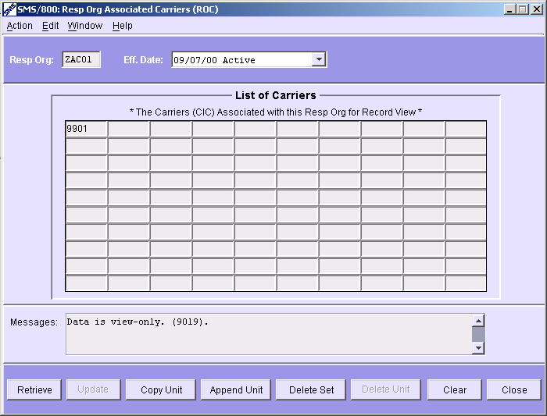
ROC (RO Associated Carriers)
Used by the Help Desk to define which Resp Org can VIEW specific CIC information in Customer Records.
ZAC01 can view 9901 carrier info on any CR where 9901 is entered
Notes:
The second screen set up by the Help Desk is the ROC.
(Click) (Click)
This screen determines the RO id that can View CR screens with the designated CIC.
(Click)
i.e. ZAC01 can view 9901 on any CR where 9901 is entered.

Slide 7
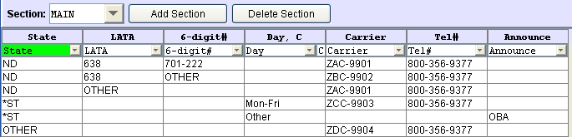
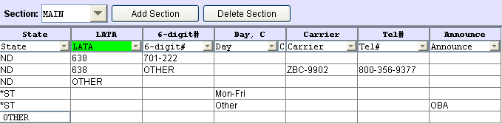
View of CPR by 9902
Controlling Resp Org sees all rows of the CPR
9902 carrier cannot view Carrier or Tel# for other Carrier Rows.
Notes:
(Click)
Controlling Resp Org sees all rows AND All Carriers of the CPR
(Click)
Managing RO for 9902 can only view their CIC and Tel# info of the CPR
(Click) (Click)

Slide 8
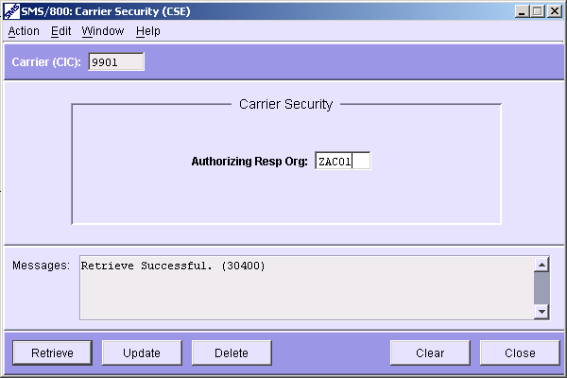
CSE (Carrier Security)
Security Screen used by the Help Desk to assign which Resp Org is associated to a carrier. Only users from this Resp Org ID can change and update the CARRIER screens.
Notes:
The CSE (Carrier Security Screen)
(Click)
Security Screen used by the Help Desk to assign which Resp Org is associated to a carrier. Only users from this Resp Org ID can change and update the CARRIER screens.
Click
Click

Slide 9
CAG (Carrier Agreements with Entities)
Allows a Carrier to list the Resp Org Entities that have permission to input this CIC in their customer records. Carrier can list each Entity separately or type two Asterisks (**) in the first field of the table to allow all ROs to type the CIC in their Customer Records
Notes:
Now we move to screens that can be updated/changed by the CIC manager.
(Click)
The first screen is the CAG screen
(Click)
Allows a Carrier to list the Resp Org Entities that have permission to input this CIC in their customer records. Carrier can list each Entity separately or type two Asterisks (**) in the first field of the table to allow all ROs to type the CIC in their Customer Records

Slide 10
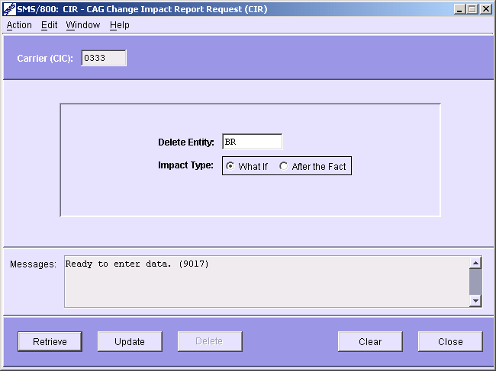
CIR
The CAG Change Impact Report Request window is used by the CIC to generate in WRS the “CAG Change Impact” Reports.
What If – What Customer records would be effected if I removed this Entity from my CAG?
After the Fact – What Customer records were affected when I removed this Entity from my CAG?
Report can only be generated in WRS once a week.
Notes:
The CIR (CAG change impact report Request) window is used by the CIC to generate in WRS the “CAG Change Impact” Reports.
(Click)
Two options are available when requesting the report:
(Click)
What If – What Customer records would be effected if I removed this Entity from my CAG?
(Click)
After the Fact – What Customer records were affected when I removed this Entity from my CAG?
(Click)
Report can only be generated in WRS once a week.

Slide 11
CAG Change Impact by Dial# Report
WHAT IF
BR
800-345-9876 03/03/03 INVALID
Notes:
This is what the WRS report “CAG Change Impact by Dial# Report” looks like.
(Click)
Carrier 0333
(Click)
wants a report that shows what records would be effected if (What if)
(Click)
they removed BR
(Click)
from their CAG screen. Only one record will be effected.

Slide 12
EAG (Entity Agreements with Carriers)
Used by an Entity (Resp Org) to view a list of carriers that the entity is allowed to use in its customer records. (RO side of the CAG screen)
Notes:
EAG (Entity Agreements with Carriers)
(Click)
This screen allows a User to view all Carriers (CICs) that the user is allowed to enter in their Customer Records.
(Click)
(Shows all CICs that have entered “BR” on their CAG screen)

Slide 13
Notification (or) Approval
Carriers have the option to have SMS/800 send them notifications or requests for Approval when Users input the Carriers CIC in designated Customer Records.
Notification
GNA/ENA
ENO
Approval
GNA/ENA
EAP
Notes:
(Click)
Carriers have the option to have SMS/800 send them notifications or requests for Approval when Users input the Carriers CIC in designated Customer Records.
(Click)
If they Just want notification for certain actions in SMS/800 they can set it up via the GNA…ENA…or ENO
(Click)
If they want Approval Requests for certain actions in SMS/800 they can set it up via the GNA…ENA…or EAP

Slide 14
GNA (General Notification and Approval)
Used by Carrier to set up the General conditions for notification and approval of customer record changes involving a specific carrier.
9901
Notes:
GNA (General Notification and Approval)
(Click)
Used by Carrier to set up the General conditions for notification and approval of customer record changes involving a specific carrier.
(Click)
For example:
(Click)
CIC manager of 9901 can set up the GNA screen in the following way:
(Click)
If 9901 is added to the routing of a Customer Record then CIC manager can have (no notification, Notify, Request Approval)
(Click)
If Possible routing change on the CR (None, Notify, Req Approval)
(Click)
CIC Deleted from routing at SCP (Working)(None, Notify)
(Click)
CIC deleted from routing at SCP (Disconnect) (None, Notify)
(Click)
Resp Org Change (none, Notify)
(Click)
The delivery method to the Carrier for Notify is default to the NOF but can be set up for MGI by entering CLLI code.
(Click)
The delivery method to the Carrier for Request Approval is default to the APR but can be set up for MGI by entering CLLI code.
(Click)

Slide 15
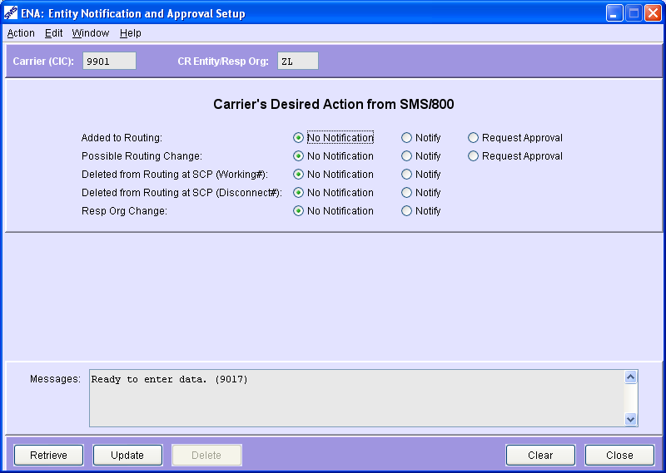
ENA (Entity Notification and Approval)
An Entity can be entered in the Entity field which will override the GNA General set up. RO ids can even further limit the SMS/800 response.
Notes:
ENA (Entity Notification and Approval)
(Click)
An Entity (i.e. ZL) can be entered in the Entity field for this CIC screen.
(Click)
The Carrier’s Desired Action from SMS/800 for this single Entity ‘ZL’ will override the GNA General set up.

Slide 16
ENO (Exception Notification)
For specific Dial#s, a Carrier can select the types of changes to the customer record that will trigger carrier notification. This will override the GNA and ENA “Notification” for the specific numbers.
ENO overrides ENA and/or GNA
ENA overrides GNA
GNA is the General setup
Notes:
ENO (Exception Notification)
(Click)
For specific Dial#s,…
(Click)
a Carrier can select the types of changes to the customer record that will trigger carrier notification. This will override the GNA and ENA “Notification” for the specific numbers.
(Click)
So, the ENO overrides the ENA and/or GNA
ENA overrides the GNA
GNA is the General Setup

Slide 17
EAP (Exception Approval)
For specific Dial#s, a Carrier can select the types of changes to the customer record that will trigger carrier a carrier-approval request. This will override the GNA and ENA Approval requests.
EAP overrides ENA and/or GNA
ENA overrides GNA
GNA is the General setup
Notes:
EAP (Exception Approval)
(Click)
For specific Dial#s,…
(Click)
a Carrier can select the types of changes to the customer record that will trigger carrier a carrier-approval request. This will override the GNA and ENA Approval requests.
(Click)
So, the EAP overrides the ENA and/or GNA
ENA overrides the GNA
GNA is the General Setup

Slide 18
NOF (Carrier Notification)
Allows a Carrier to View and Delete CR-change notification messages sent on-line within a specified date range.
Notes:
NOF – Carrier Notification…
(Click)
Allows a Carrier to View and Delete CR-change notification messages sent on-line within a specified date range.
(Click)
I.e. 866-888-7682 … On 07/19/02 … 9901 was added to Routing … it is Awaiting Approval from us.

Slide 19
APR (Carrier Approval)
Allows a Carrier to view a list of CRs that are awaiting the Carrier’s response (TBD), have been denied (NO), and/or have been approved (YES).
-TBD
-Denied
-Approved
Notes:
APR (Carrier Approval)
(Click)
Allows a Carrier to view a list of CRs that are:
(Click)
TBD - waiting the Carrier’s response
NO - have been denied
YES - have been approved

Slide 20
APR DENIAL CODES (Used by Involved Routing Carriers)
Reason Code Description
01 - Syntax Error (In Customer Record)
02 - Toll Free Number not Working
03 - Toll Free Number Cancelled or Disconnected
04 - Routing Change Not Allowed Per Carrier Tariffs
05 - Carrier Does Not Support Multi-Carrier Routing
06 - No Customer Request for Toll Free Number in Carrier System
07 - Routing Request Conflicts with Customer Contract
These CODES are not universally agreed upon by Carriers
Notes:
APR denial codes used by Involved Routing Carriers
Reason Code Description
(Click)
01 - Syntax Error (In Customer Record)
(Click)
02 - Toll Free Number not Working
(Click)
03 - Toll Free Number Cancelled or Disconnected
(Click)
04 - Routing Change Not Allowed Per Carrier Tariffs
(Click)
05 - Carrier Does Not Support Multi-Carrier Routing
(Click)
06 - No Customer Request for Toll Free Number in Carrier System
(Click)
07 - Routing Request Conflicts with Customer Contract
(Click)
These CODES are not universally agreed upon by Carriers.
(Click)

Slide 21
SAP
Allows the Controlling Resp Org to view a list of their Customer Records awaiting approval responses from a CIC owner.
Notes:
The SAP/DAP screen has 2 tabs .
(Click)
The SAP
(Click)
Allows the Controlling Resp Org to view a Summary list of their Customer Records awaiting approval responses from a CIC owner.

Slide 22
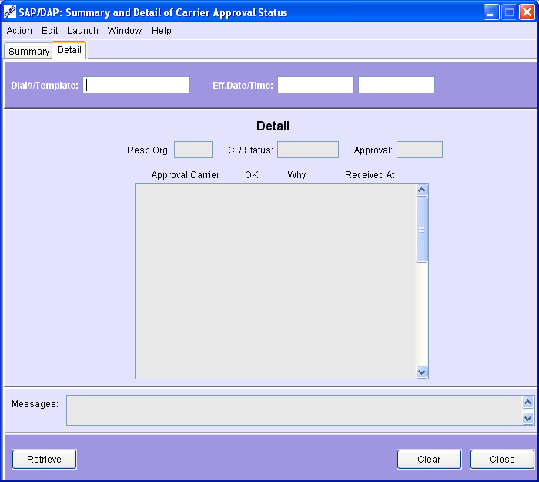
DAP
Allows a Control Resp Org to view details about the Carrier (CIC) approval responses received for a specific Dial# or Template. Can be accessed under menu item “Launch” on CAD.
Launch
Notes:
(Click)
Allows a Control Resp Org to view details
(Click)
about the Carrier (CIC) approval responses received for a specific Dial#.
(Click)
Can be accessed under menu item “Launch” on CAD.

Slide 23
Use of 0110 in Customer Records
OTC-0110 is used as the IntraLata CIC terminating to 701-222-1696. The LEC who manages POTS # 701-222 is Qwest. So the use of the generic 0110 means, “Use the LEC that manages this POTS #”, which is Qwest. (The 2nd use of 0110 to 708-220 means use SBC.)
Notes:
This is how 0110 is used in the CPR. It is only used to route intra lata traffic (Only within a Lata)
(Click)(Click)
In this example OTC-0110 is used as the IntraLata CIC terminating to 701-222-1696.
(Click)
The LEC who manages POTS # 701-222 is Qwest. So the use of the generic 0110 means, “Use the LEC that manages this POTS #”, which is Qwest.
(Click)
(The 2nd use of 0110 to 708-220 means use SBC.) because SBC manages that POTS#.

Slide 24
Screens For LECs That Terminate
Toll Free Traffic using 0110
There are three screens for LECs who wish to take advantage of the OTC- 0110 Feature to control Toll Free traffic terminating to their POTS numbers. These three screens are:
1. The Operating Company Numbers (OCN) Screen (Filled out by the Help Desk by form 47)
2. The Carrier Intralata Agreements (CLA) Screen
3. The Carrier Intralata Exceptions (CLE) Screen
Unless and until a LEC makes entries in a CLA or a CLE screen, or the NSP fills out the NLA, NCA or NLE this feature will not initiate any changes in how 0110 is used currently in the SMS/800 data base.
Notes:
There are three screens for LECs who wish to take advantage of the OTC- 0110 Feature to control Toll Free traffic terminating to their POTS numbers. These three screens are:
(Click)
1. The Operating Company Numbers (OCN) Screen
(Click)
2. The Carrier Intralata Agreements (CLA) Screen
(Click)
3. The Carrier Intralata Exceptions (CLE) Screen
Unless and until a LEC makes entries in a CLA or a CLE screen, or the NSP fills out the NLA, NCA or NLE this feature will not initiate any changes in how 0110 is used currently in the SMS/800 data base.

Slide 25
Screens for Network Service Providers (NSP)
For purposes of the OTC- 0110 Feature , source data file identifies Network Service Providers as AT&T, Cincinnati Bell, Qwest, or Verizon. (SB, VO, UW)
There are four screens that Network Service Providers can use to manage Toll Free traffic that originates on or traverses their networks:
1. The Network Company Codes (NCC) Screen
2. The Network IntraLata Agreements (NLA) Screen
3. The Network Carrier Exceptions (NLE) Screen
4. The Network Carrier Agreements (NCA) Screen
Notes:
Screens for Network Service Providers
(Click)
For purposes of the OTC- 0110 Feature , source data file identifies Network Service Providers as AT&T, Cincinnati Bell, Qwest, or Verizon. (SB,VO, UW)
(Click)
There are four screens that Network Service Providers can use to manage Toll Free traffic that originates on or traverses their networks:
(Click)
The Network Company Codes (NCC) Screen
(Click)
2. The Network IntraLata Agreements (NLA) Screen
(Click)
3. The Network Carrier Exceptions (NLE) Screen
(Click)
4. The Network Carrier Agreements (NCA) Screen

Slide 26
Upon Update, record becomes INVALID with error displayed in message field
Carrier
Screen
CANNOT USE TEL# 7012221696 WITH CIC 0110 PER ENTITY UW CLA SCREEN. *** CPR LINE:ND ->638 ->OTC0110 ->7012221696A ? *** PROBLEM TEL# : 7012221696A (4640)
Notes:
Upon Update, record becomes INVALID
(Click)
with error displayed in message field
(Click)
CANNOT USE TEL# 7012221696 WITH CIC 0110 PER ENTITY UW CLA SCREEN. *** CPR LINE:ND ->638 ->OTC0110 ->7012221696A ? *** PROBLEM TEL# : 7012221696A (4640)

Slide 27
NXL Informational Screen (cont.)
LATA OCN CO Eff Date Status
638 9631 31 4/10/86 Active
For any inserted NPA/NXX number, the NXL screen will display information from the most recent Terminating Point Master (“TPM”), which is issued bi-monthly. The screen will identify the LATA where the NPA/NXX number resides, the Operating Company Number of the LEC that manages that NPA/NXX number, and the Company Code of the NSP that also manages that NPA/NXX.
If, due to LNP(Local Number Portability) or other issues, the OCN is not accurate, the NEW terminating LEC can allow or disallow a Resp Org to route traffic to the number using the RAC or RDC screen
The Resp Org can use the SMS/800 database to look up the contact information for the LEC and the NSP, so that the Resp Org can pursue the necessary approvals.
Notes:
(Click)
For any inserted NPA/NXX number, the screen will display information from the most recent Terminating Point Master (“TPM”), which is issued bi-monthly. The screen will identify the LATA where the NPA/NXX number resides, the Operating Company Number of the LEC that serves that NPA/NXX number, and the Company Code of the NSP that serves that NPA/NXX.
(Click)
If, due to LNP(Local Number Portability) or other issues, the OCN is not accurate, the NEW terminating LEC can allow or disallow a Resp Org to route traffic to the number using the RAC or RDC screen (see slide 24-25).
(Click)
The Resp Org can use the SMS/800 database to look up the contact information for the LEC and the NSP, so that the Resp Org can pursue the necessary approvals. (see slide 26).

Slide 28
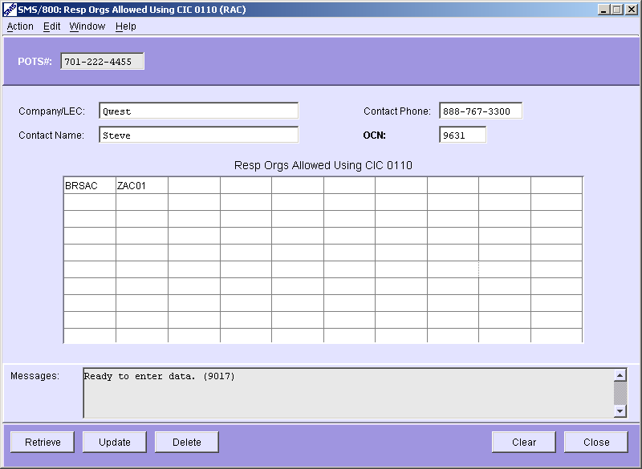
RAC (Resp Orgs Allowed Using CIC 0110)
The POTS# field can be the 10 digit POTS or can contain wild cards as the last 3 characters. (indicating a block of 1000 numbers)
If a POTS# is ported from one LEC to another LEC, the new LEC can send in a request (form 110) to the HELP DESK to have specific Resp Orgs added to this screen. Any Resp Orgs added to this screen will have permission to use 0110 to the indicated POTS#. (i.e. *****, ZA***, ZAC01) Any Resp Org not listed on this screen will NOT have permission to use 0110 to the indicated POTS#.
Notes:
RAC (Resp Orgs Allowed Using CIC 0110) All other Ros will not be allowed.
(Click)
If a POTS# is ported from one LEC to another LEC, the new LEC can send in a request (form 110) to the HELP DESK to have specific Resp Orgs added to this screen. Any Resp Orgs added to this screen will have permission to use 0110 to the indicated POTS#. (i.e. *****, ZA***, ZAC01) Any Resp Org not listed on this screen will NOT have permission to use 0110 to the indicated POTS#.
(Click)
The POTS# field can be the 10 digit POTS or can contain wild cards as the last 3 characters. (indicating a block of 1000 numbers)

Slide 29
CPR Before Conversion
CPR After Conversion (Invalid Use)
Notes:
The Conversion Job will make the following changes:
(Click)(Click)
CPR before conversion will look like: Lata 638 – 0110 – 701-222-1234
(Click)(Click)
CPR after conversion will look like: Lata 638 – 0110 - OBA

Slide 30
CNA – Review
Who Views the CNA
Involved Routing Carrier
CNA Screens
0110 Screens
Written Exercise CNA #13
Hands-On Exercises Extras A-L
Notes:
Please answer the Written Exercises and Complete Hands On Exercises.

